Slide 1
Udemy Courses Data Analysis PDS 17

Slide 2
Project analysis slide 2
Table of Contents
Brief History of Udemy
Data Analysis Process
Questions
Hypothesis
Analysis
Insights

Slide 3
Project analysis slide 2
Brief History of Udemy
Udemy is an online learning platform which was created in May 2010. Offering free and paid courses, the site has more than 50 million students and 57,000 instructors teaching courses in over 65 languages – as of January 2020. The company has headquarters in San Francisco, California (USA) and is a subsidiary of Sunnytrail Insight Labs Inc.

Slide 4
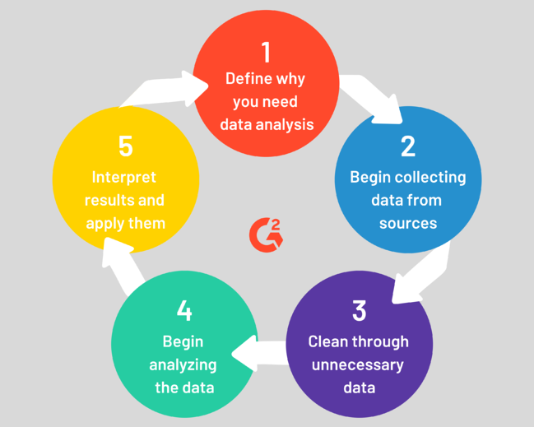
Project analysis slide 2
Data Analysis Process
First there has to be reason for needing data analysis. This may because of a problem or to test a theory. The data to be analyzed is then collected and cleaned. The cleaned data is then analyzed to gain insights. The results of the data is then interpreted and used to answer or solve business questions.

Slide 5
Project analysis slide 2
About the Dataset
The Udemy courses dataset used for this project:
Contained 3,682 records [Raw Data]
Across 4 subjects (Business Finance, Graphic Design, Musical Instruments and Web Design)
And 4 difficulty levels (All levels, Intermediate, Beginner, Expert)
The data records were between the years 2011 and 2017
P. S. :After cleaning and removing duplicates, the dataset contained 3,672 records.

Slide 6
Project analysis slide 2
Hypothesis
Our team hypothesizes that “Subscribers are generally interested in Business Finance related courses”

Slide 7
Project analysis slide 2
Questions
Some questions that are to be answered by this analysis includes:
What are the most expensive courses?
What are the total number of free and paid courses?
What are the total number of courses per subject?
What are the most subscribed courses?

Slide 8
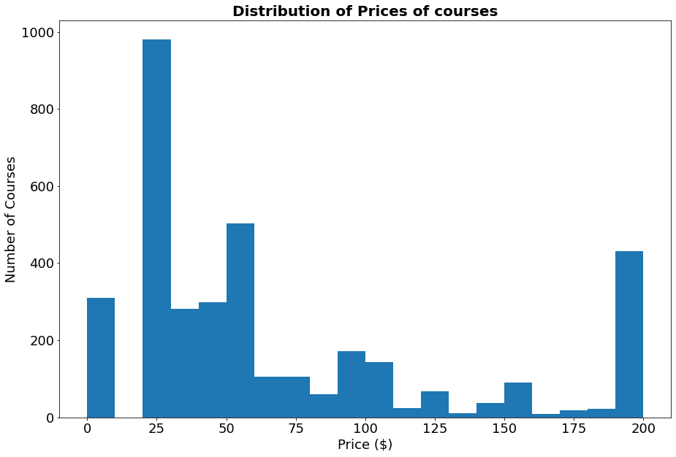
Project analysis slide 2
Data Analysis
Courses Price Distribution
The prices of the courses range from 0 (free courses) up to 200 dollars. Most of the courses are in the price range of 25 to 60 dollars with sparse courses in above 100 dollars.

Slide 9
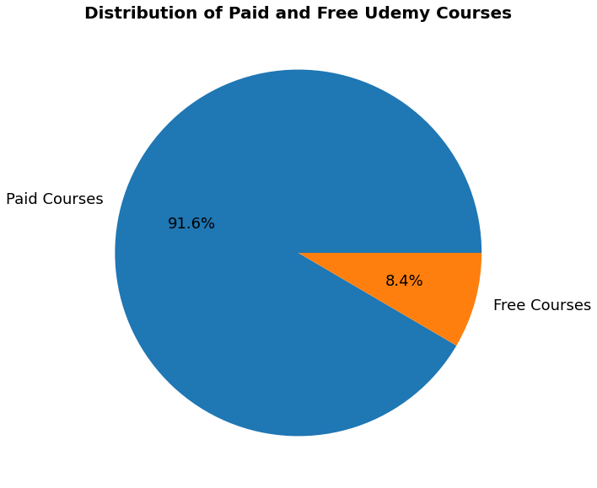
Project analysis slide 2
Data Analysis
Paid and Free Courses Distribution
From the dataset, Udemy had 3,364 paid courses and 310 free courses accounting for 91.6% and 8.4% of the total courses respectively.

Slide 10
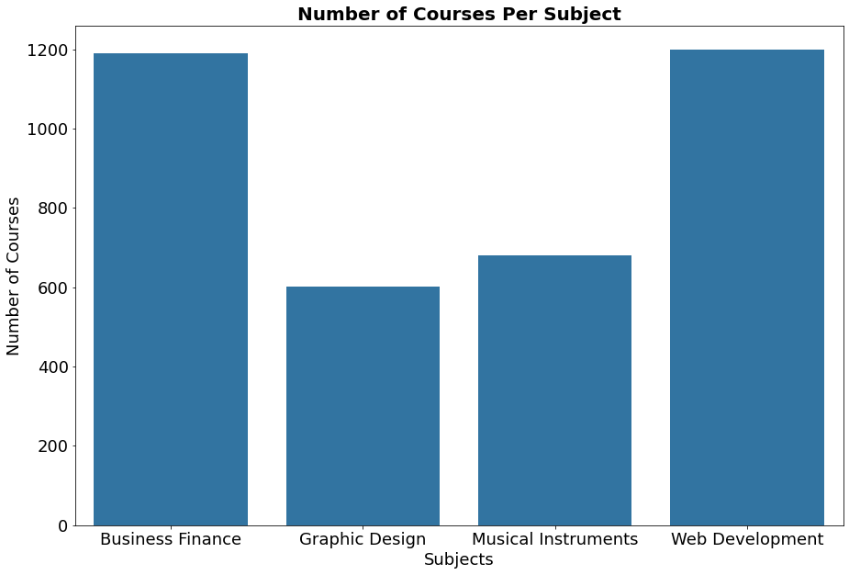
Project analysis slide 2
Data Analysis
Number of Courses per Subject
Most the courses were categorized between the subjects of Web Development and Business Finance. This accounts for more than two-thirds of the total courses with the remaining one-third categorized between Musical Instruments and Graphic Design.
Subjects | No. of Courses
Web Development | 1,199
Business Finance | 1,191
Musical Instruments | 680
Graphic Design | 602

Slide 11
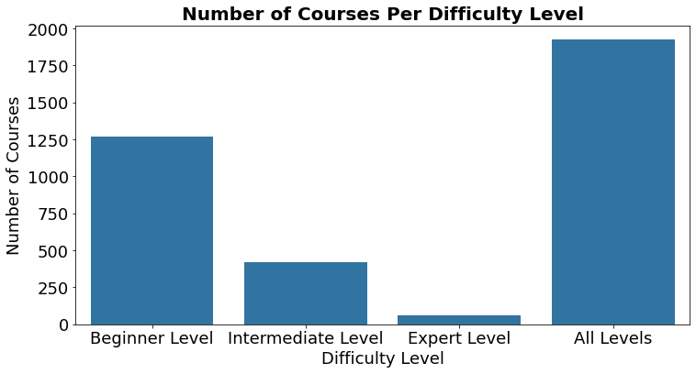
Project analysis slide 2
Data Analysis
Course Difficulty Levels
More than two-thirds of the courses are for All Levels or Beginner Levels with 1,925 and 1,268 courses respectively. Expert Level has the least courses with 58 courses in total.

Slide 12
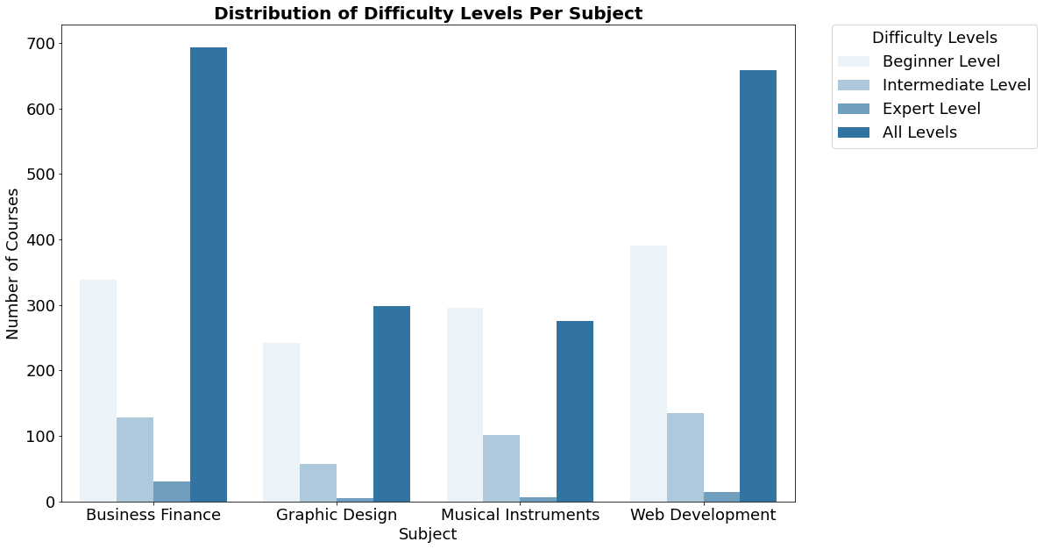
Project analysis slide 2
Data Analysis
Further broken down into subjects, most courses offered are for All Levels and Beginner levels

Slide 13
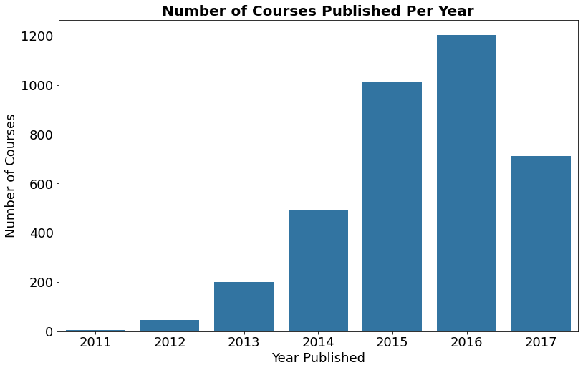
Project analysis slide 2
Data Analysis
Courses Published Per Year
Starting with less than 100 courses in 2011, there has been dramatic increase in the number of courses on the platform up until 2016. From its peak in 2016, the number of courses almost halved within a year.

Slide 14
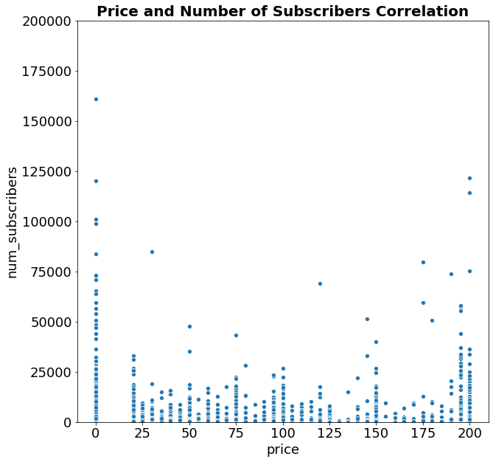
Project analysis slide 2
Data Analysis
Price and Number of Subscribers Correlation
There is no clear correlation between the price and the number of subscribers.
It appears the Price does not determine the number of subscribers
However, the free courses with have the most subscribers.

Slide 15
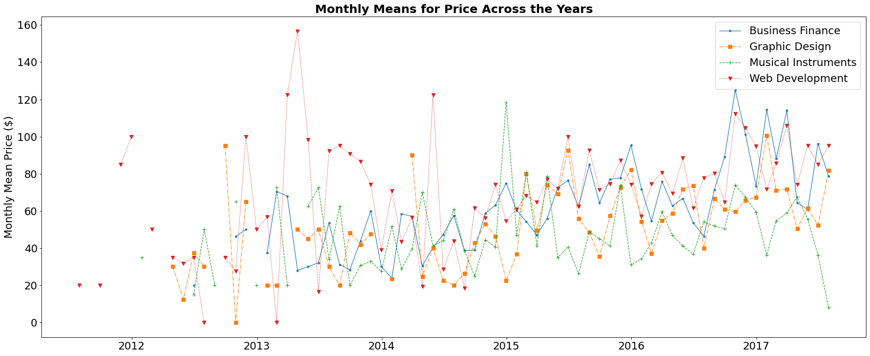
Project analysis slide 2
Data Analysis
……..

Slide 16
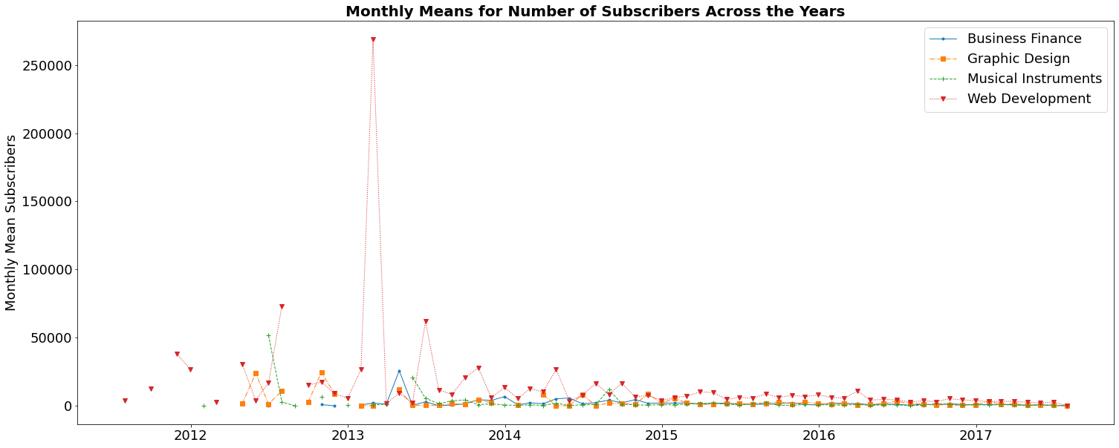
Project analysis slide 2
Data Analysis
……..

Slide 17
Project analysis slide 2
Conclusion

Slide 18
Thank You

Slide 19
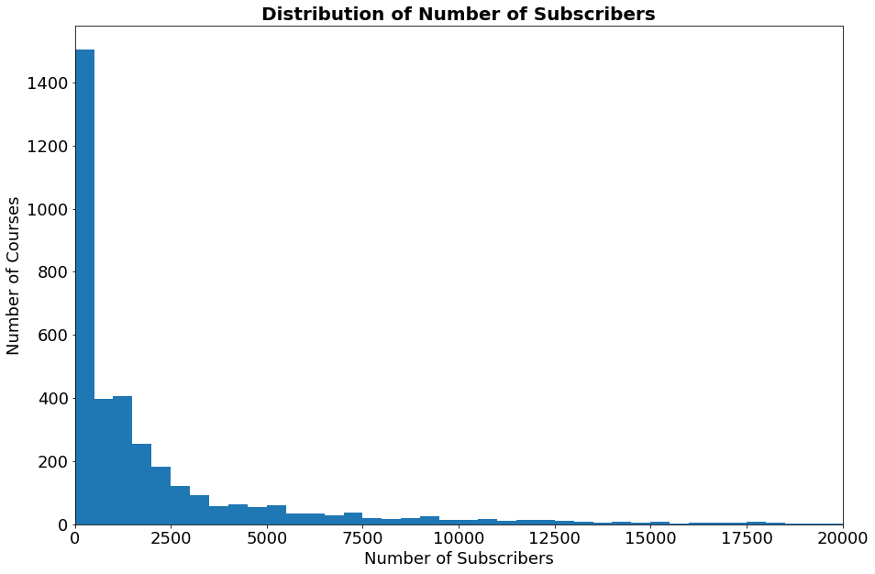
Project analysis slide 2
Data Analysis
Number of Subscribers Distribution

